Slide 1
HTML Introduction

Slide 2
Key Topics
Application Re-Introduction
HTML
Attributes
Common Elements

Slide 3
Application
Re-Introduction

Slide 4
What is an Application?
An application is a computer program with an interface, enabling people to use the computer as a tool to accomplish a specific task – from dictonary.com
Interface: provides a means of interaction between two things. Two types:
GUI: graphical user interface
uses color, buttons, graphics for the user to use to interact with the program
CLI: command-line interface
uses mostly text-based commands for the user to use to interact with the program

Slide 5


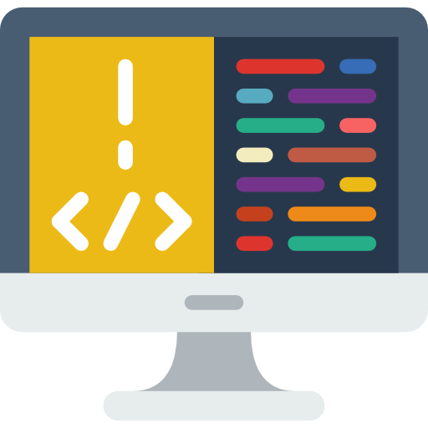


Common Web App Architecture
Client
Server
Database
Java is a server-side language
HTML, CSS, and JS are client-side languages for the web
SQL is a database language
Notes:
Back End Computer icon by prettycons from flaticons.com
Browser and Phone icon by Freepik from flaticons.com
Database Computer icon by Freepik from flaticons.com
Plug icon by Freepik from flaticons.com
Envelope icon by Dinosoftlabs from flaticons.com
Cycle icon by Flat Icons from flaticons.com

Slide 6
What is HTML?

Slide 7
Markup Language
NOT a programming language
Programming languages are used to give the computer instructions
Markup languages are used to give describe or format content
Content can be text, image, videos, etc

Slide 8
Browsers
Browser: application that is used to surf the world wide web
World Wide Web: network of webpages that have content we can view and interact with
Webpages are also known as hypertext.
They can be linked together to navigate between them
Webpages have addresses or URLs that allows us to find them

Slide 9
Web Browsers and Source Files
Web browsers can read and understand HTML, CSS, and JavaScript
HTML: Hypertext Markup Language
markup language that structures and describes web content
The browser renders (draws) HTML documents into static content the user can view
CSS: Cascading Stylesheets
can be used to change how the browser displays HTML content
JavaScript: programming language that can be used to cause the browser to perform additional tasks and modify the HTML or CSS used to render a file.
Allows for dynamic content

Slide 10
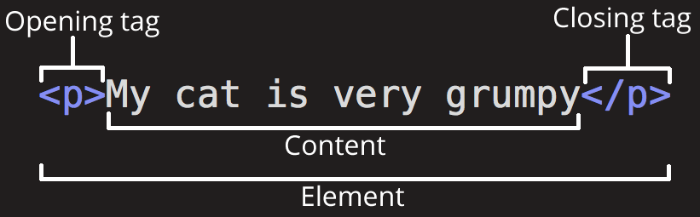
HTML
Markup language that is made up of elements
Element: building blocks of your HTML document
Can represent information about your document
Can represent an individual piece of content

Slide 11
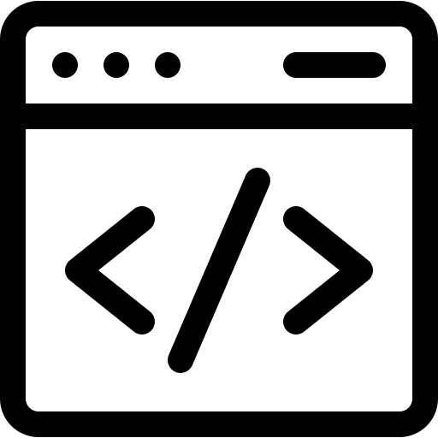
Boilerplate Elements
Every HTML page must have these 5 elements to be “valid”:
!DOCTYPE
html
head
title
body
<!DOCTYPE html>
<html>
<head>
<title></title>
</head>
<body>
</body>
</html>
Notes:
Demonstrate using Notepad
Code icon by Freepik from flaticons.com

Slide 12
Other Common Elements
Headings
Paragraphs
Lists
Ordered
unordered
Tables
Anchors
Images
Notes:
Demonstrate using VS Code

Slide 13
Common HTML Attributes
Attributes add “metadata” to an element
they describe what the element is doing.
Some attributes are only used with specific HTML elements
Other attributes are usable by every HTML element
id=“value”: used to give a unique ID to a single element
class=“value” : used to group elements for styling or scripting purposes.
Can have multiple values separated by spaces
style=“key:value;”: used to set styling directly on an element.
Can have multiple key:value pairs, separated by semicolons (;)
Notes:
If time, anchor tag demonstration

Slide 14
Recall
What is an application?
What is a markup language?
What is HTML?
What are the 5 boilerplate HTML elements?
What are other common HTML elements?
What are HTML attributes?

